Slide 1
Bank of Baroda Hackathon 2024
Your Team Name : OutfitX
Your team bio : A skilled team excelling in full-stack
development and machine learning and Innovaters
Date : 30-06-2024

Slide 2
Risk Management
Critical Importance in the Financial Sector
Opportunity for Technological Innovation
Real-Time Data Analysis
Personal and Professional Growth

Slide 3
Pre-Requisite
Machine Learning-Based Solutions
Innovative Use of Generative AI
Real-Time Data Analysis
User-Friendly Interface
Innovation and Customization

Slide 4
Tools or resources
Azure Machine Learning
Azure Data Factory
Azure Stream Analytics
Generative AI
Kaggle
Power BI
Azure DevOps

Slide 5
Any Supporting Functional Documents
Solution : Real-time risk identification, predictive insights, and actionable mitigation strategies while ensuring regulatory compliance.
Methodology :
Data Collection and Preparation
AI Modeling Techniques
Continuous Learning
Architecture: Cloud-Native Architecture on Azure
Scalability : Elastic Scaling Capabilities

Slide 6
Key Differentiators & Adoption Plan
Innovative Use of Generative AI
Real-Time Data Analysis
Comprehensive Risk Coverage
User-Friendly Interface
Scalability and Flexibility
Partnerships and Collaborations
Education, Training and Awareness
Integration with Existing Systems
Continuous Improvement and Feedback Loop

Slide 7
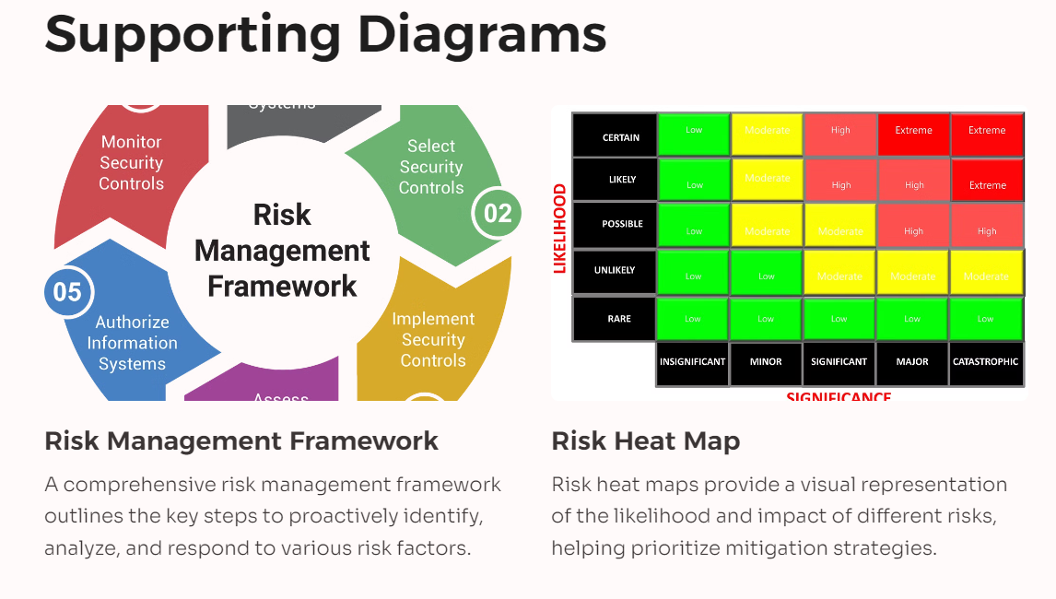
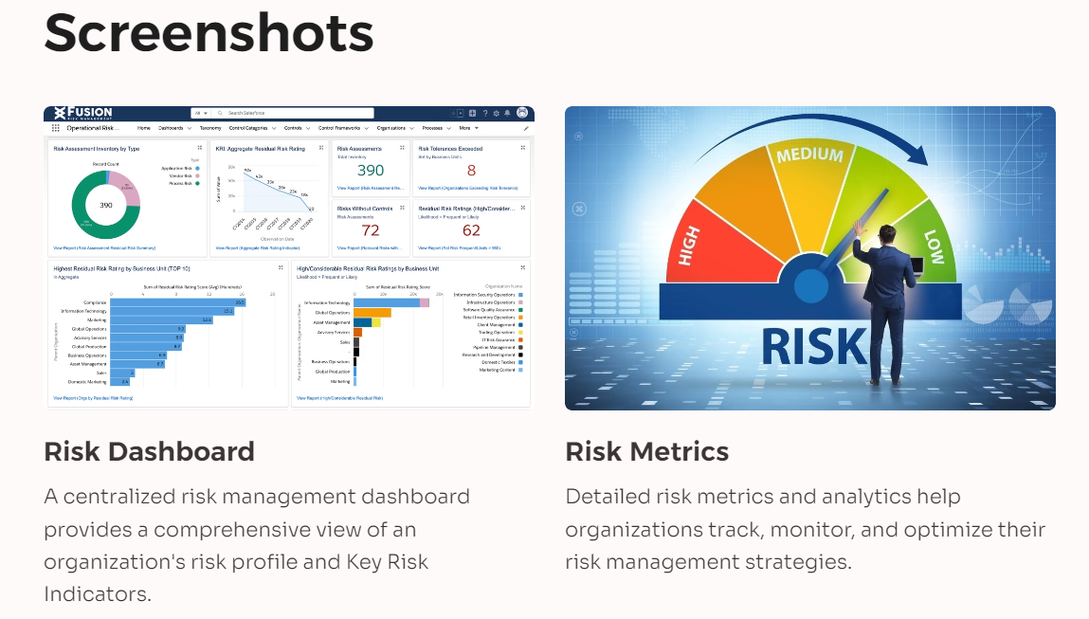
GitHub Repository Link & supporting diagrams, screenshots, if any
GitHub Link : https://github.com/AravaChoudhary/Risk_Management_OutfitX.git

Slide 8
Business Potential and Relevance
Market Risk Management
Credit Risk Management
Operational Risk Management
Strategic Planning and Decision Making
Compliance and Regulatory Reporting
Investment Management

Slide 9
Uniqueness of Approach and Solution
Generative AI for Scenario Generation
Real-Time Data Analysis and Anomaly Detection
Regulatory Compliance and Automated Reporting
User-Friendly and Interactive Dashboards
Enhanced Security and Data Privacy

Slide 10
User Experience
Personalized Risk Insights
Collaborative Risk Management
Real-Time Decision Support
Training and Support
Continuous Improvement and Feedback Loop

Slide 11
Scalability
Cloud-Native Architecture
Data Management and Storage
Performance Monitoring and Optimization
Security and Compliance
Capacity Planning and Forecasting

Slide 12
Ease of Deployment and Maintenance
Automated Operations and Monitoring
User Training and Support
Scalability and Flexibility
Continuous Improvement

Slide 13
Security Considerations
Data Encryption and Privacy
Access Control and Authentication
Network Security
Compliance and Regulatory Adherence
Third-Party Risk Management

Slide 14
Thank You
Team member names :
Arava Choudhary
Aayush Kawadia
Ritesh kumar

